Slide 1


HEART DISEASE
Abhishek Jain - 1
Apurva Deore - 11
Vedang Sawant - 55
Vedant Rathi - 44

Slide 2


ABOUT THE DATA
This dataset provides information on the risk factors for heart disease. The original database contains 76 attributes, but all published experiments refer to using a subset of 14 and is referenced as Cleveland dataset.
Experiments with the Cleveland database have concentrated on attempting to distinguish presence (value 1) or absence (value 0) of heart disease in the patient.

Slide 3
Attribute Information:
Age
Sex: Sex : male=1;female=0
ChestPain: typical = 0, asymptotic=1, nonanginal=2, nontypical=3
Resting BP
Cholestrol :in mg/dl
FBS: Fasting blood sugar > 120 mg/dl
(1 = true; 0 = false)
RestECG: Resting electrocardiographic results
Maximum heart rate
ExAng: Exercise induced angina (1 = yes; 0 = no)
Oldpeak: ST depression induced by exercise relative to rest
Slope: Slope of the peak exercise ST segment
Ca: Number of major vessels colored by flourosopy (0 - 3)
Thal: (3 = normal; 6 = fixed defect; 7 = reversable defect)
AHD - Diagnosis of heart disease (1 = yes; 0 = no)
DATABASE

Slide 4
THE LIBRARIES USED:
import numpy as np
import pandas as pd
import matplotlib.pyplot as plt
import seaborn as sn
from sklearn.model_selection import train_test_split
from sklearn.linear_model import LogisticRegression
from sklearn.metrics import classification_report
from sklearn.metrics import confusion_matrix

Slide 5
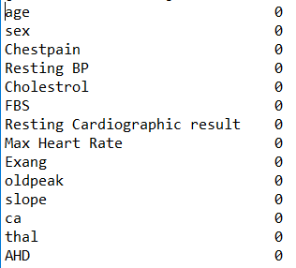
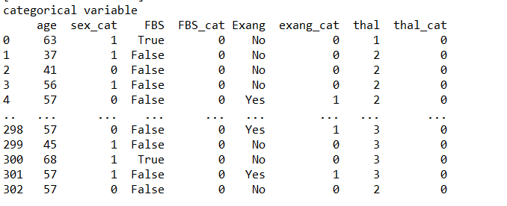
Data Preprocessing:
Data Pre-processing involves checking from missing values and creating dummy varibles.
data.isnull().sum()-function used to calculate the null values in the data frame.
Dummy variables creation:

Slide 6
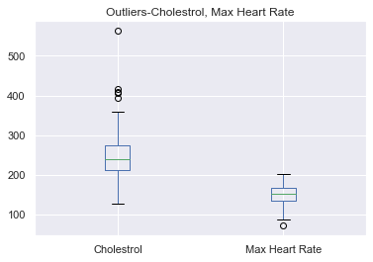
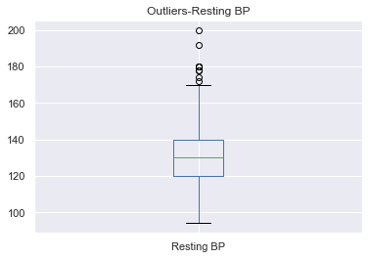
OUTLIER DETECTION:
Code:
X = data.boxplot( column =['Cholestrol','Max Heart Rate'])
plt.title("Outliers-Cholestrol, Max Heart Rate")
plt.show()
Y=data.boxplot( column =['Resting BP'])
plt.title("Outliers-Resting BP")
plt.show()

Slide 7
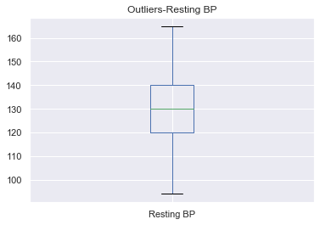
OUTLIER DETECTION:
Code:
q1 = data['Resting BP'].quantile(0.25)
q3 = data['Resting BP'].quantile(0.75)
iqr = q3-q1 #Interquartile range
fence_low = q1-1.5*iqr
fence_high = q3+1.5*iqr
data= data.loc[(df['Resting BP'] > fence_low) & (df['Resting BP'] < fence_high)]
X = data.boxplot( column =['Resting BP'])
plt.title("Outliers-Resting BP")
plt.show()

Slide 8
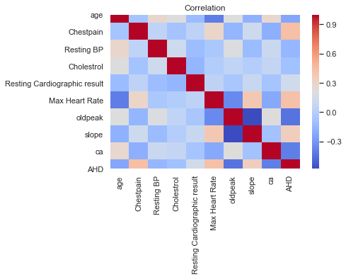
Correlation

Slide 9
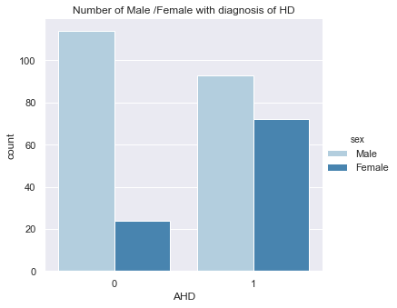
HEART DISEASE:
The following bar chart shows the variation between a male and female having Heart Disease.
0-No heart disease
1-Heart disease
As we can see the number of male with heart diseases are more than female.

Slide 10
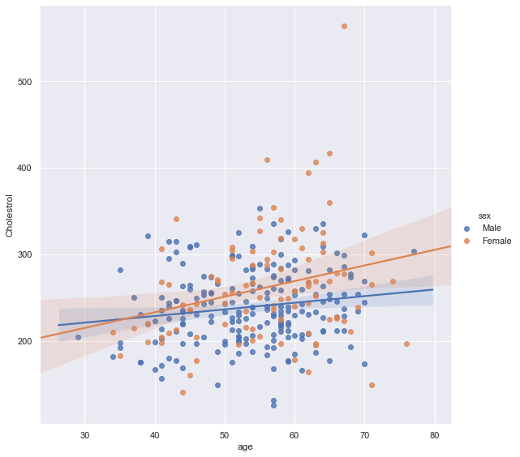
HEART DISEASE:
The following scatterplot shows how age and cholesterol level are related for male and female.
As we can see the rate of increase of cholesterol level is more in females than in male.

Slide 11
MODEL BUILDING:
SPLITING THE DATASET INTO TRAINING AND TESTING DATA:
X_train, X_test, y_train, y_test = train_test_split(data.drop(['AHD','sex','FBS','Exang','thal'],axis=1),data['AHD'], test_size=0.30, random_state=101)
Fit the Model:
logmodel = LogisticRegression()
logmodel.fit(X_train, y_train)
PREDICTING VALUES FOR TEST DATA:
Predictions = logmodel.predict(X_test)
GETTING THE CLASSIFICATION REPORT AND CONFUSION MATRIX:
print(classification_report(y_test,Predictions))
print(confusion_matrix(y_test, Predictions))

Slide 12
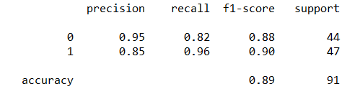
MODEL OUTPUT:
Classification report:
Code:
print(classification_report(y_test,Predictions))
Function from library-”from sklearn.metrics import classification_report”
From the built model we get an Accuracy of 89%.

Slide 13
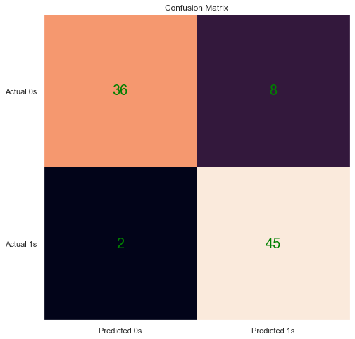
MODEL OUTPUT:
Confusion matrix:
Code:
print(confusion_matrix(y_test, Predictions))
Function from library-”from sklearn.metrics import confusion_matrix”
Model Performance:
Accuracy: 89%
Sensitivity: 95.7%
Specificity:81%
Precision:84.9%

Slide 14
THANK YOU

Slide 15
https://github.com/vedang13sawant/Pythonproject19-20.git

